Slide 1

Supply Chain Management
By Raktim Samui

Slide 2
Overview
An FMCG company entered into the instant noodles business two years back. Their higher management has noticed that there is a miss match in the demand and supply. Where the demand is high, supply is pretty low and where the demand is low, supply is pretty high. In both ways, it is an inventory cost loss to the company; hence, the higher management wants to optimize the supply quantity in every warehouse in the entire country.

Slide 3
Objective
Goal & Objective: This exercise aims to build a model, using historical data that will determine the optimum weight of the product to be shipped each time to the warehouse.
Also, try to analyze the demand pattern in different pockets of the country so management can drive the advertisement campaign, particularly in those pockets.
This is the first phase of the agreement; hence, the company has shared very limited information. Once you are able to showcase a tangible impact with this much information then the company will open the 360-degree data lake for your consulting company to build a more robust model.

Slide 4
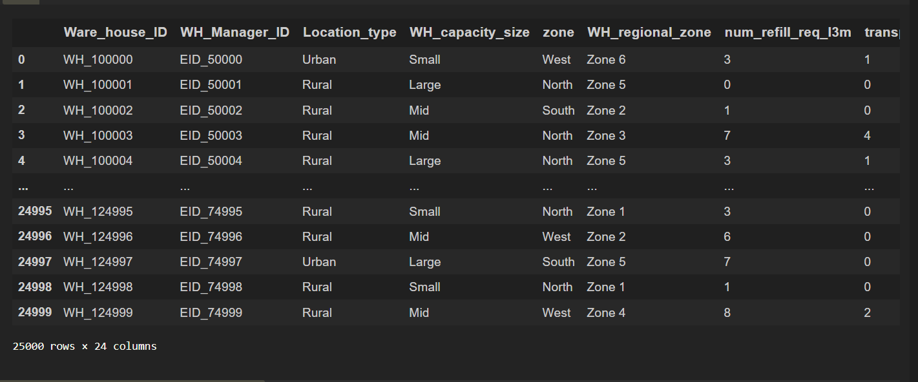
The Data

Slide 5
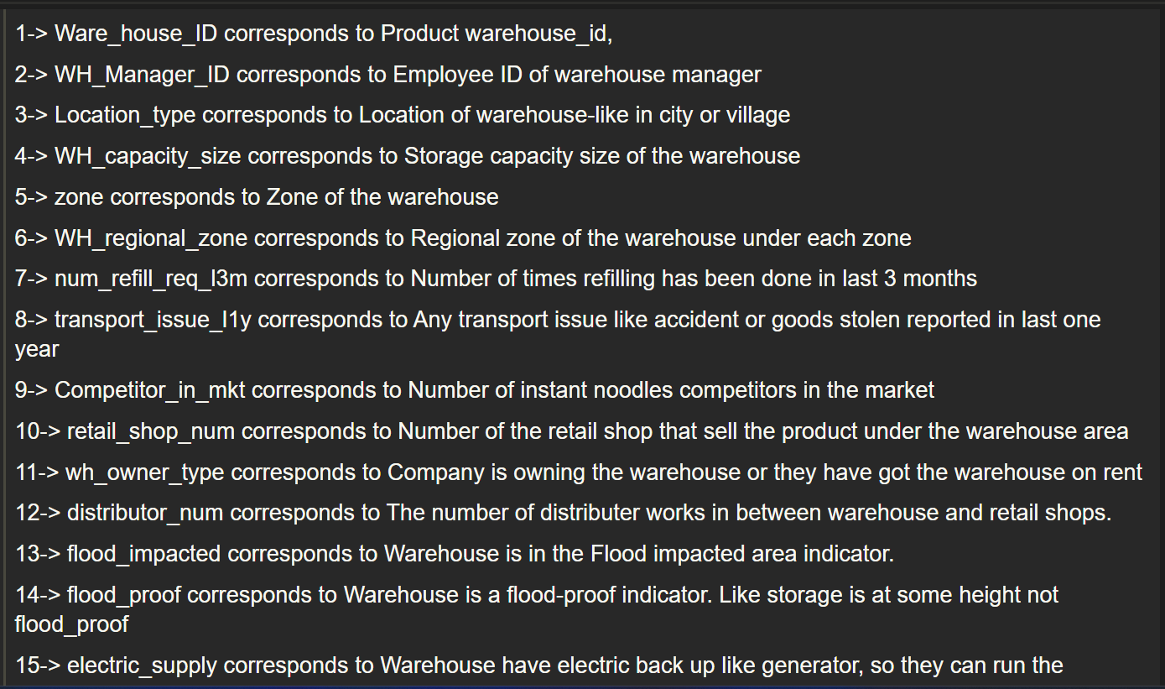
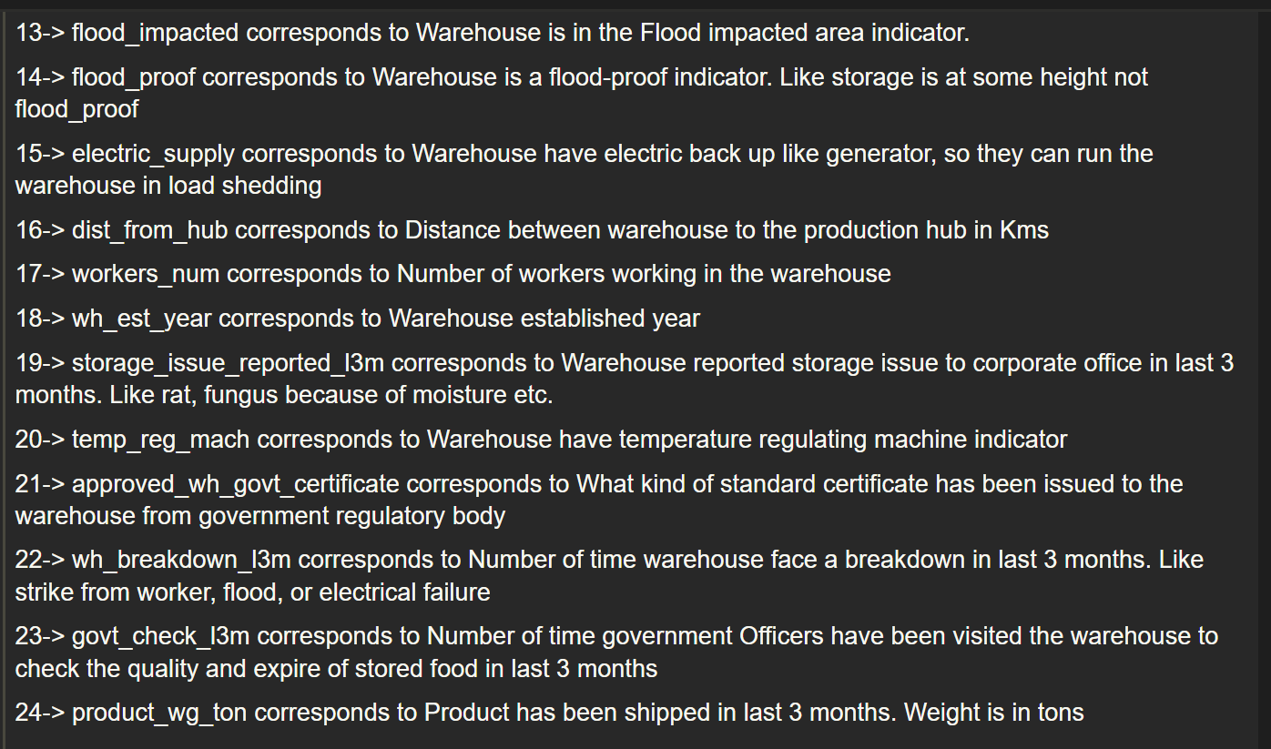
About The Data
25 Columns X 25000 Rows

Slide 6
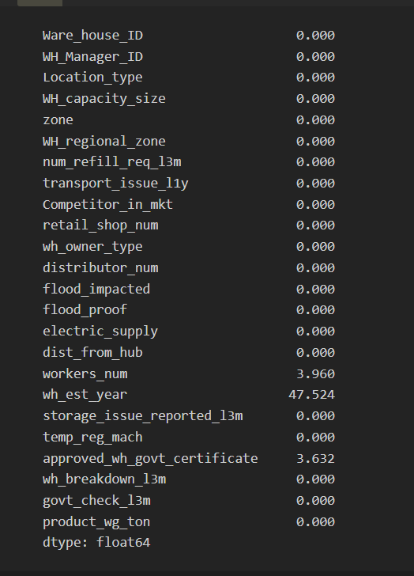
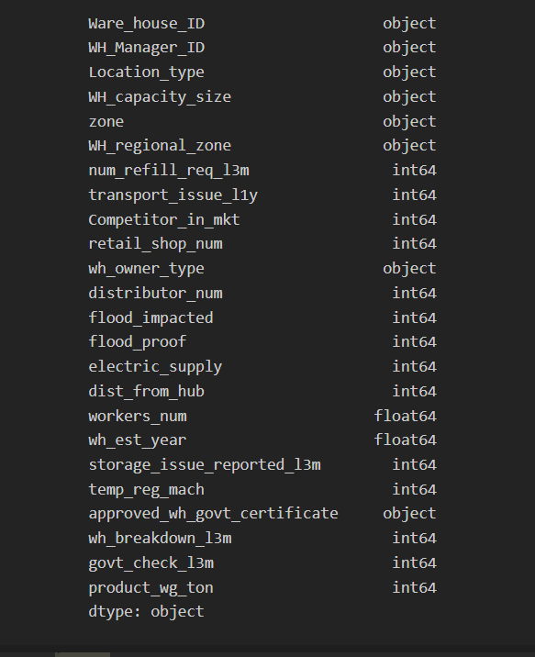
Percentage of Null Values
Datatypes of the Features

Slide 7

Exploratory Data Analysis

Slide 8
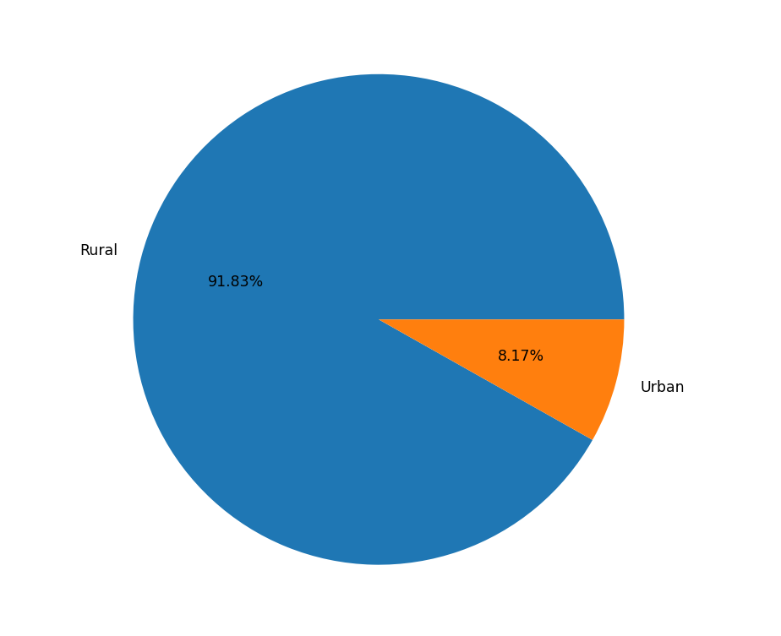
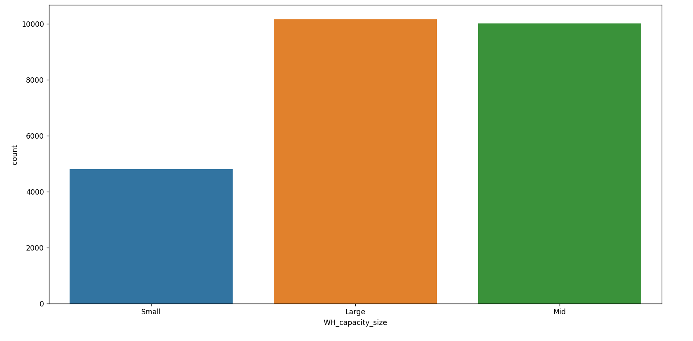
Percentage of Warehouses Location Wise
Number of different sizes of warehouses

Slide 9
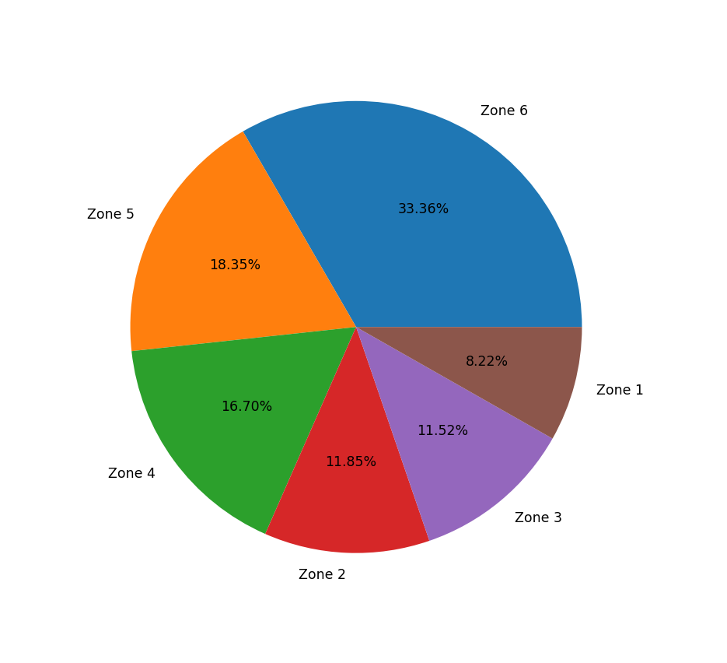
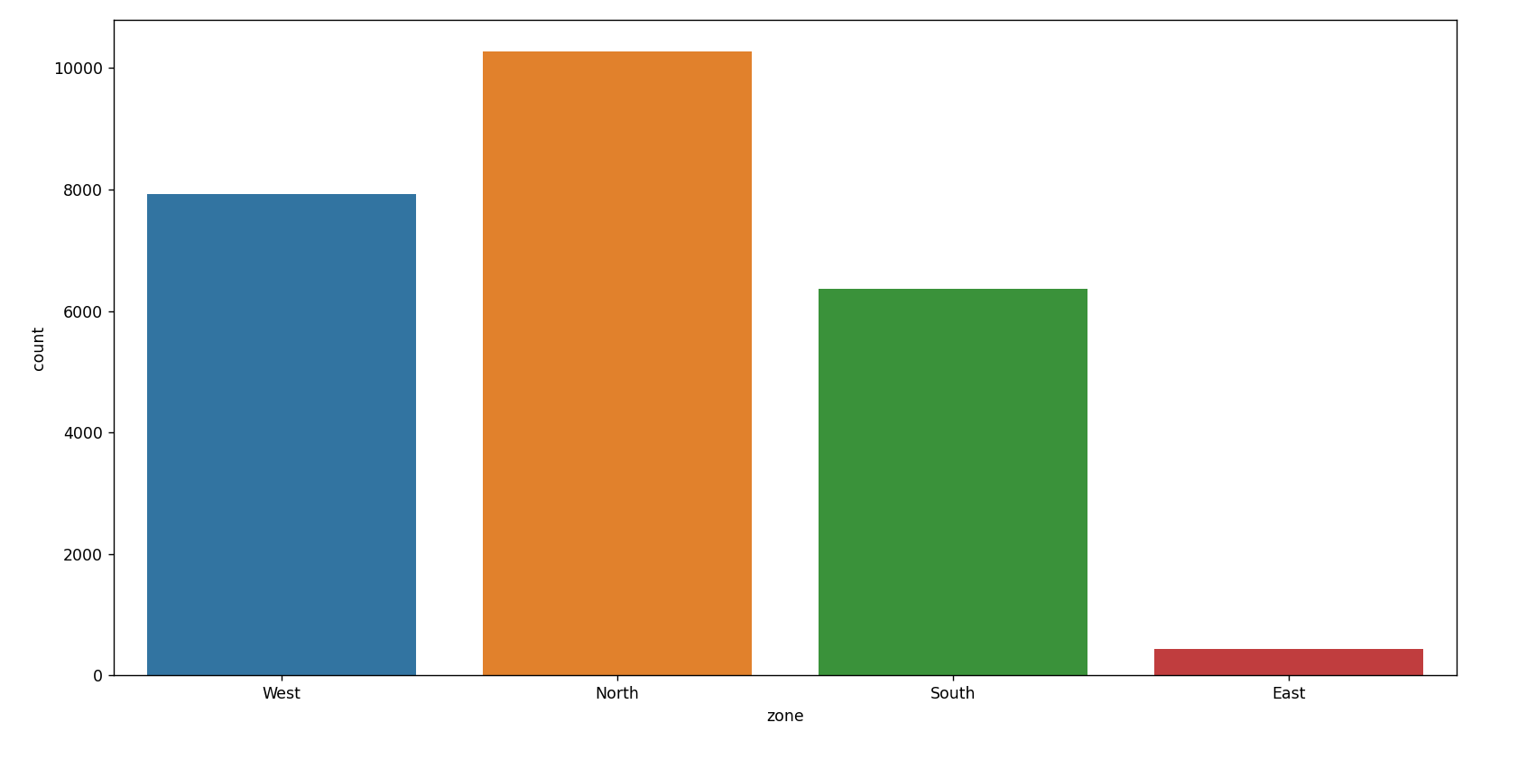
Number of warehouses in different zones of the country
Percentage of warehouses in different regional zones of the country

Slide 10
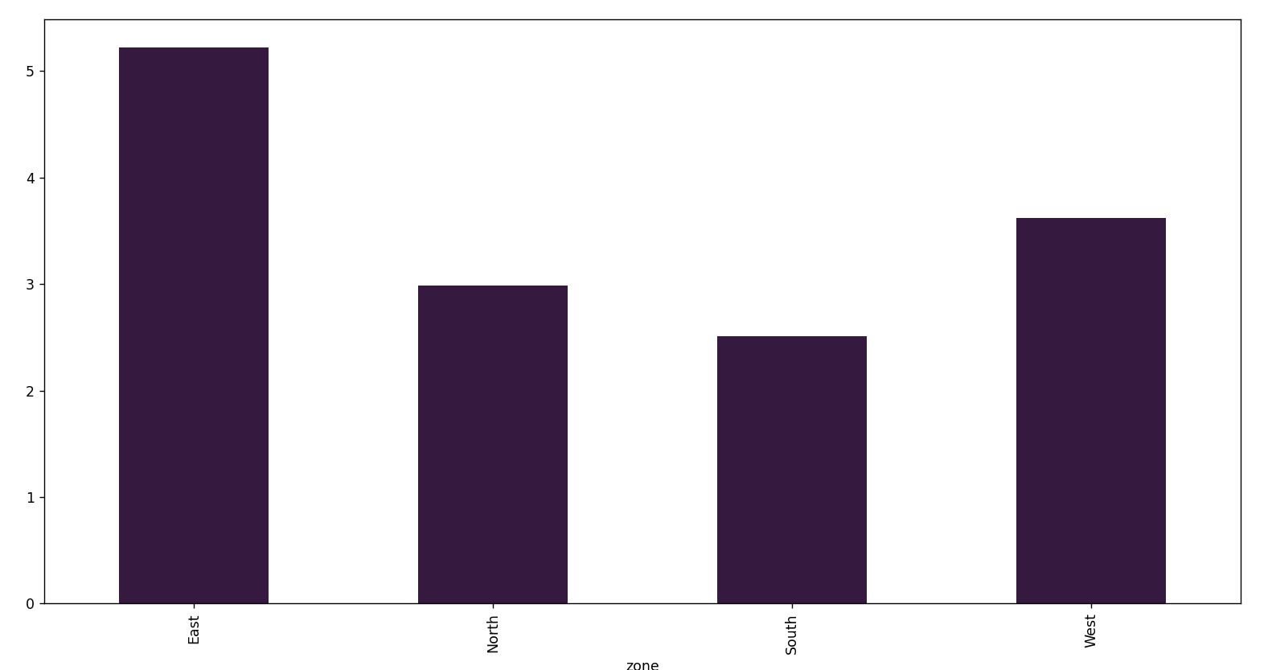
Average number of competitors in the market zone Wise
We see that the average number of competitors in the east zone is quite high as compared to other zones

Slide 11
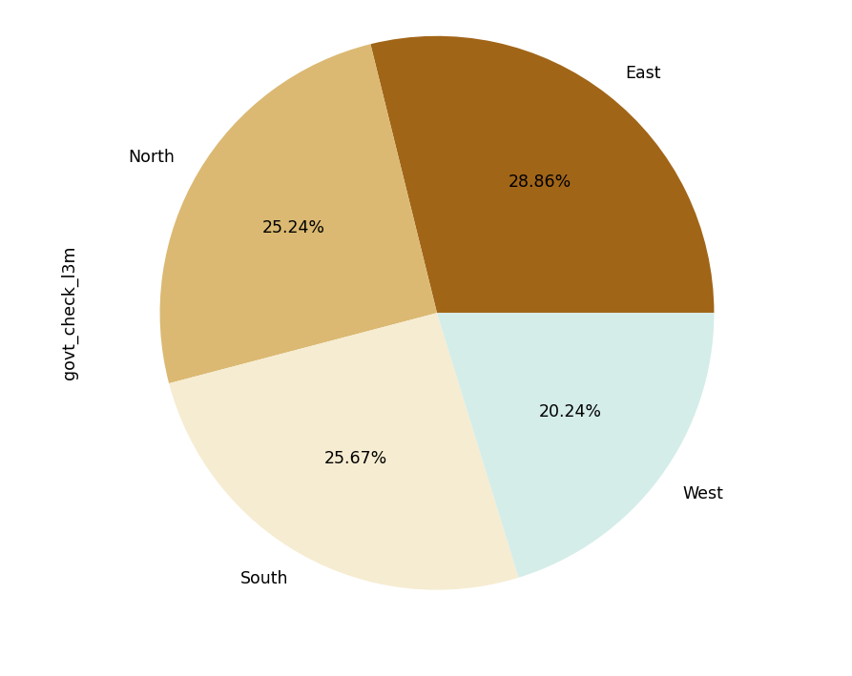
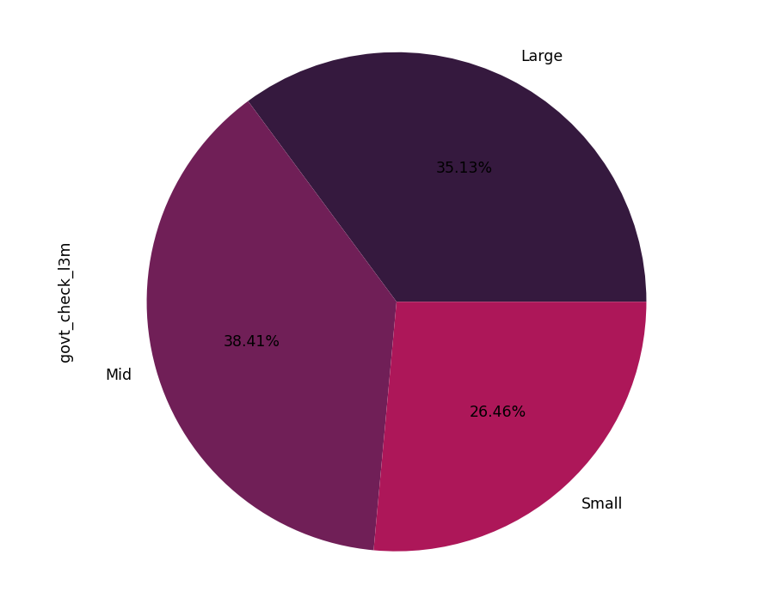
We see on average there is quite high percentage of government checks in our mid and large warehouses compared to the small, similarly we also see there are quite high percentage of government checks in the east, north and south zone warehouses.

Slide 12
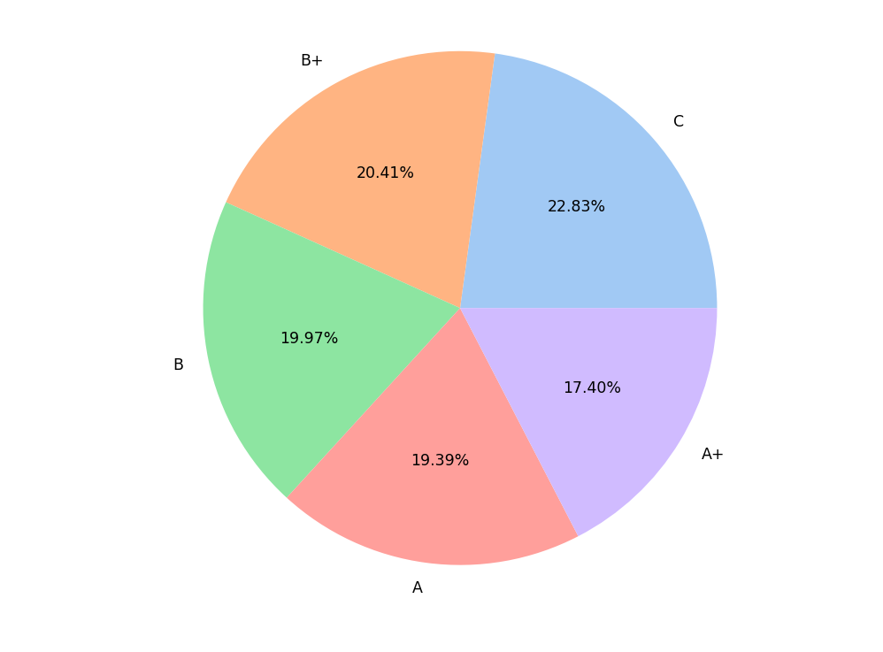
Talking about government, the certificates received from the government are mostly low grade

Slide 13
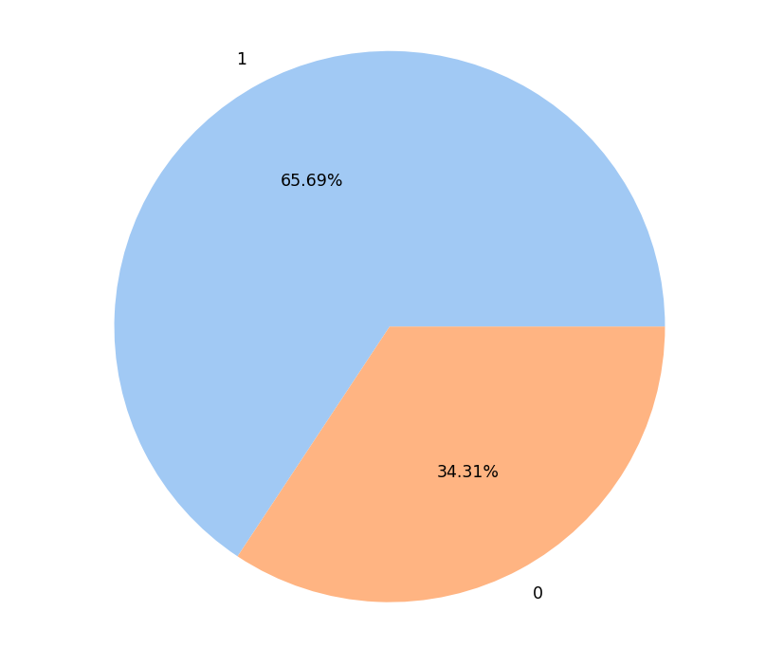
Percentage of warehouses with Electric Backup Present or not
34% percent of the warehouses do not have electric backup such as generators and hence cannot run the warehouse in load shedding

Slide 14
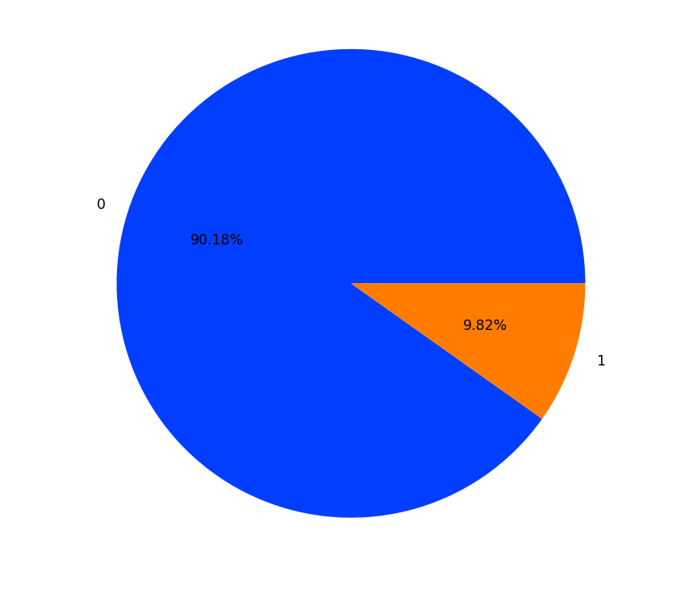
Percentage of warehouses in flood impacted area.

Slide 15
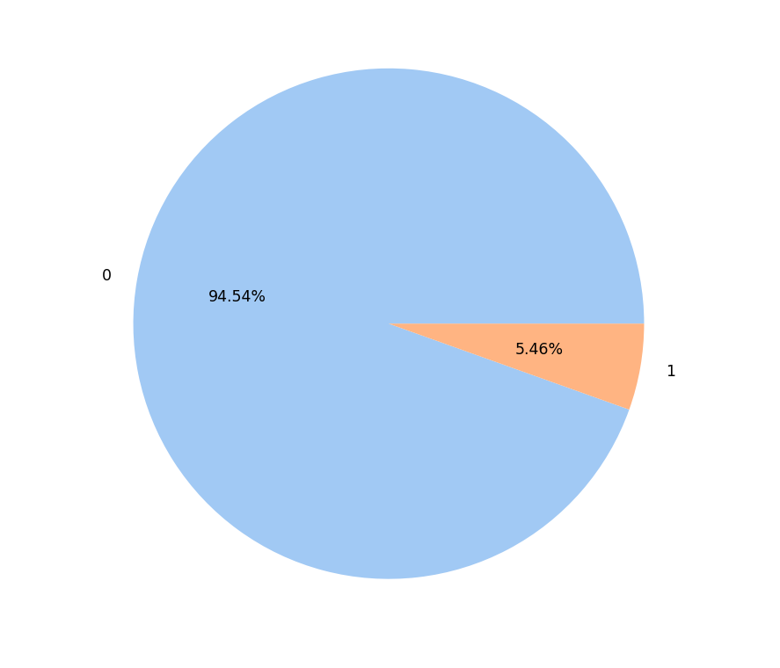
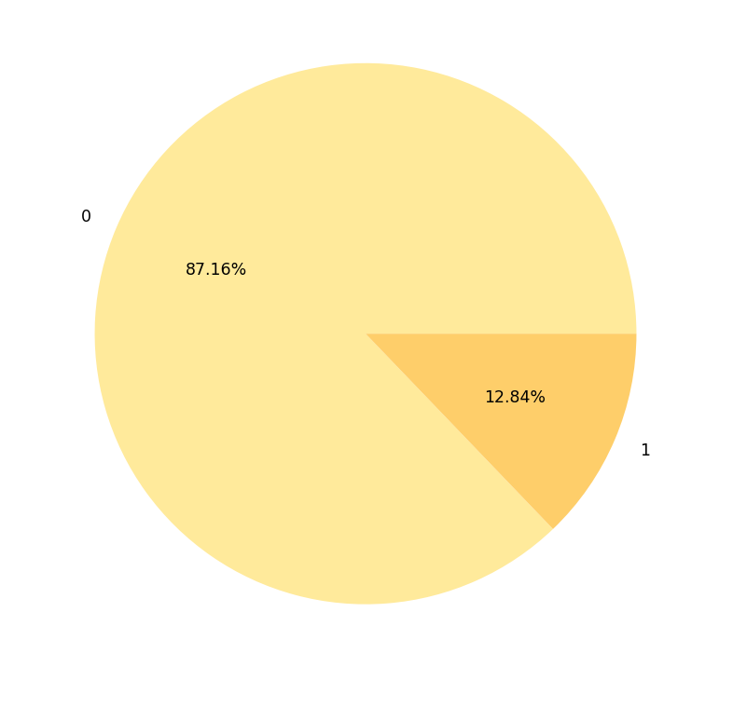
Percentage of warehouses that are flood proof or not and are in flood impacted area
Percentage of warehouses that are flood proof or not
Out of all the warehouses only around 5% of them are flood proof rest are not, hence we can see out of all the flood impacted areas only 12% of the warehouses there are flood proof.

Slide 16
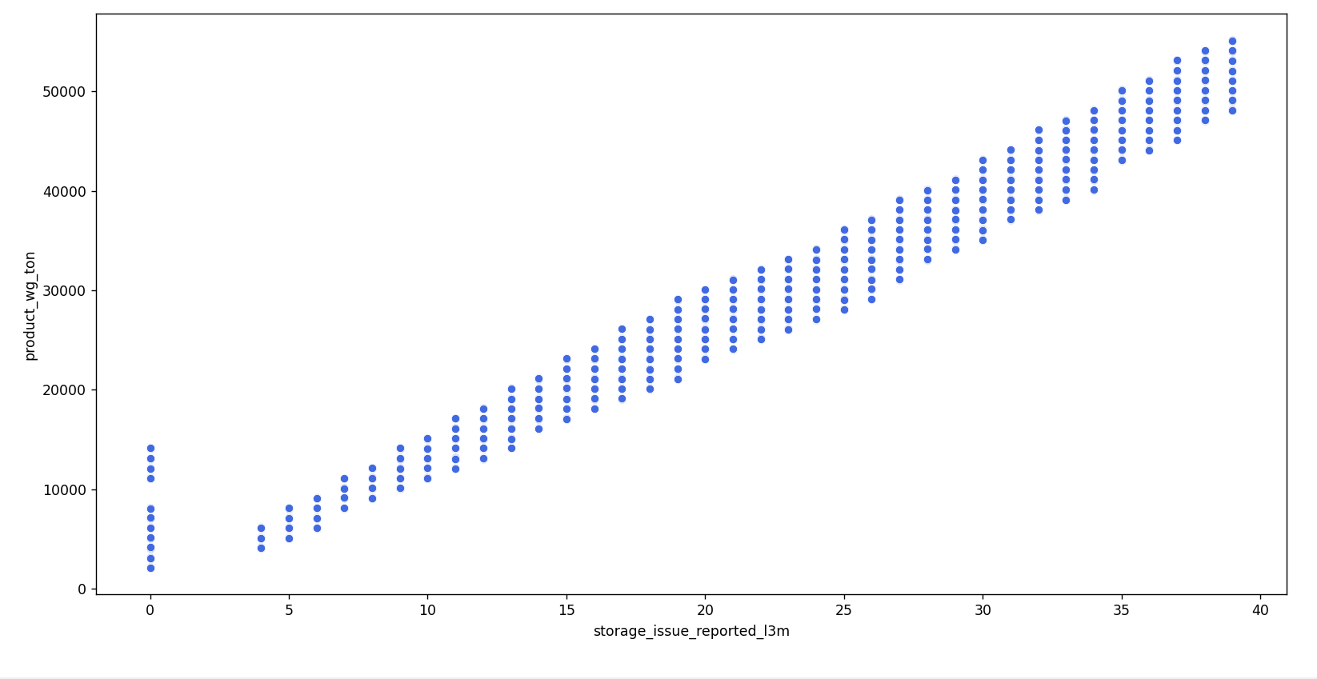
On doing some Bivariate analysis we find out that the target variable and the feature that is storage issue reported in last 3 months are pretty strongly and positively correlated around 0.99, hence we can say that this is one of the most important features in our data

Slide 17

Analyzing Market Demand in different pockets of the Country

Slide 18

Overview of Demand Analysis
we can get an idea of demand pattern using 3 variables from the data that is:
num_refill_req_l3m which states the number of times refill was required in the last 3 months, now since refill was required meaning the products were sold rapidly and hence to maintain the stock refilling of goods was done.
we can also use retail_shop_num which states the Number of retail shop that sell the product under the warehouse area as more the number of shops selling the product, more the demand of the products.
lastly we can use the target variable that is product_wg_ton which states the weight of products shipped in last 3 months in tons, this gives us an idea of the demand as more the weight of products shipped more the demand.

Slide 19
Analysis and Findings
The complete analysis of each of the variables can be found in the .ipynb notebook submitted and is not possible to fit in the scope of this presentation but let's checkout the most prominent findings from this analysis
Firstly using the num_refill_req_l3m variable we find out that the average demand is same location wise, zone wise as well as regional zone wise.
We find the same with retail_shop_num feature that is average demand is same location wise, zone wise as well as regional zone wise.
However with the product_wg_ton feature we find that there is 7% more demand of the product in the urban areas as compared to rural areas, this is visualized in the chart in the next slide.

Slide 20
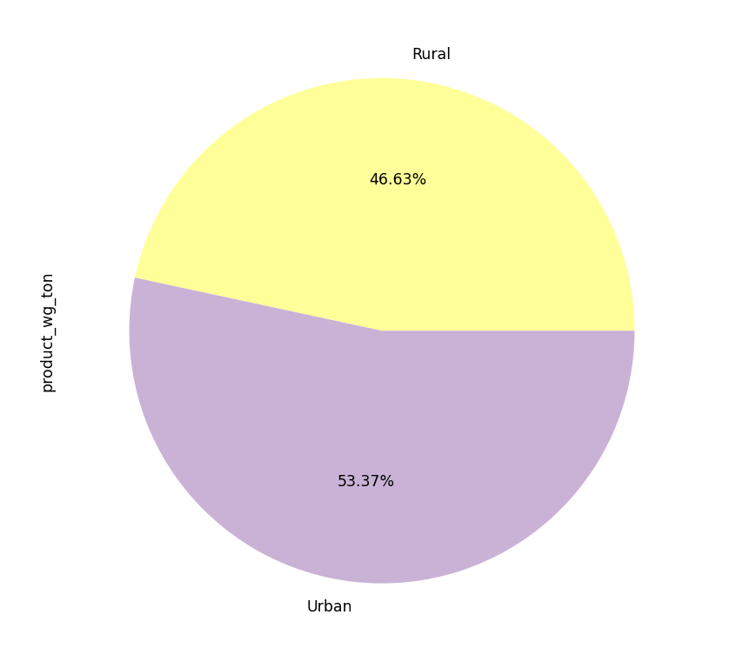
Average product weight shipped location wise in last 3 months.

Slide 21

Data Preprocessing

Slide 22
Data Preprocessing Overview
Our Data Preprocessing techniques involved:
Handling Null Values
Removing Nuisance Columns
Outlier Treatment
Feature Encoding
Handling Multicollinearity
Feature Scaling
Feature Selection/Feature Importance/Feature Reduction

Slide 23
Handling Null Values
In the data there were 3 features that had null values. These were wh_est_year that consisted 47% percent null values, workers_num that contained around 4% null values and approved_wh_govt_certificate that contained around 3% null values.
We dropped the feature wh_est_year that had 47% percent null values as it is a categorical feature and hence cannot be imputed, we can try mode imputation here however since a very high number of records are null using mode imputation can make the data imbalanced.
We use mode imputation for the approved_wh_govt_certificate as only 3% of values are null hence we can fill the values with mode.
Lastly to fill the workers_num we first check the distribution of this feature and we find out that it is quite normally distributed hence we use the mean as our measure of central tendency to fill the null values.

Slide 24
Handling Nuisance Columns & Outlier Treatment
In our data the Ware_house_ID and WH_Manager_ID are the features that are not required in any way as they are unique columns and consist id of warehouses and the mangers hence we remove these features.
As for Outlier Treatment we find out that all of the numerical columns are either normally distributed or are result of natural variation hence no requirement for outlier treatment.

Slide 25
Encoding
In our data we have few categorical features which are required to be encoded
However there are two types of categorical features that is categorical nominal data and categorical ordinal data, we encode nominal data using one hot encoding and encode the ordinal data using ordinal encoding.
Location_type, WH_capacity_size, zone, WH_regional_zone, wh_owner_type and approved_wh_govt_certificate are the categorical features in our data where WH_capacity_size and approved_wh_govt_certificate are ordinal features and rest are nominal.

Slide 26
Handling Multicollinearity and Data Scaling
We do not find very highly correlated features. Though as we saw before, we do see that the feature storage_issue_reported_l3m and the target variable are very strongly correlated.
As for feature scaling we went ahead with Standardization instead of Normalization as that is generally better as Standardization centralizes the data while normalization retains the shape of the data.

Slide 27
Feature Importance
Mutual information is calculated between two variables and measures the reduction in uncertainty for one variable given a known value of the other variable. A quantity called mutual information measures the amount of information one can obtain from one random variable given another.
The MI which is the measure of dependence between the random variables is zero only if the variables are independent.

Slide 28

Modelling

Slide 29

Algorithms
Linear Regression
Decision Tree
Random Forest

Slide 30
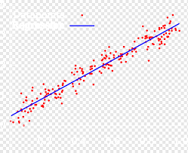
Basic Overview of Linear Regression
Now Linear Regression works in such a way that it tries to fit a line to through the data that can best predict the dependent feature, mathematically speaking it tries to find the best slope value and a bias value that can predict our dependent feature using an optimization technique called gradient descent where we try to reduce the loss function in case of linear regression that is Mean Squared Error, now this is when we have only one input feature when we have many input features things change a bit but the overall concept stays the same.

Slide 31
Results with Linear Regression Algorithm
Now on fitting the data to Linear Regression Algorithm we get the accuracy in this case that is R squared as 0.976 for training set and 0.977 for test set, which is excellent as we managed to get this good accuracy for train as well as test set with the first algorithm only and that too without any overfitting, bias or variance.

Slide 32
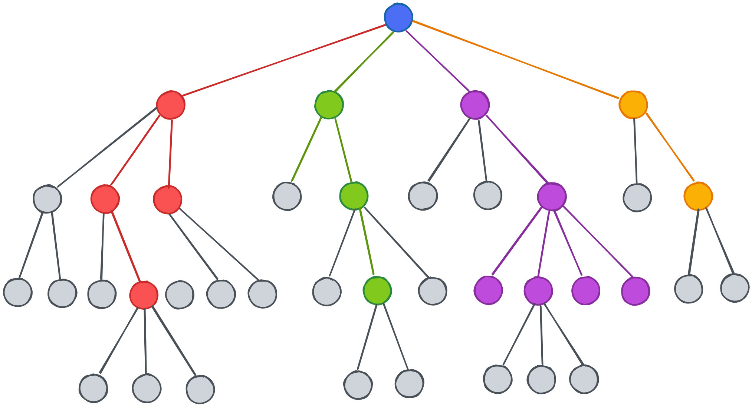
Basic Overview of Decision Tree
Decision Tree algorithm also called as CART is very popular in terms of classification, now decision tree works in a way that is called as recursive partitioning where simply put it does simple if else partition on the features recursively one level after another where the first node is called the root node and every node that gets split further is called a decision node and the node that does not get split further is called a leaf node. Now there are different flavors of decision tree which help us to perform the partitioning or split that I initially mentioned in case of classification these include 1 - Entropy & Information Gain 2 – Gini Index.
Now in case of Regression most of the stuff stays the same, what changes is the that instead of Entropy & Information Gain or Gini Index we have another concept called variance reduction where for each partition or split we try to find out the partition that reduces the variance in target variable with each successive split in case of classification we try to find the partition that reduces the entropy in the target variable and reduction in entropy is called information gain.

Slide 33
Results with Decision Tree Algorithm
Initially we used Linear Regression Algorithm and got great results, but this time we used Decision Tree Algorithm to see if we can get even better results and as expected we did, that is on fitting the data to the Decision Tree Algorithm we observe the accuracy (R squared) to be 1.0 for training set and 0.98 for test set and again as we see that without overfitting, bias or variance hence Decision Tree Algorithm for this data is better than the Linear Regression Algorithm.

Slide 34

Basic Overview of Random Forest
Random Forest is an Algorithm which is an enhanced version of Decision Tree with a few small changes. Random Forest is part of Ensemble Learning algorithm and quite similar to Bagging algorithm where multiple subsets of the data is created using random sampling with replacement method and then each of these subsets are fit to any state of the art machine learning model hence we get multiple machine learning models and each having a random subset of the data and the result is calculated by considering all of these models.
Now Random Forest performs in the same manner just the difference is that it not only does row shuffling it also does feature shuffling when doing random sampling with replacement and the state of the art model is fixed and it is none other than Decision Tree.

Slide 35
Results with Random Forest Algorithm
Now we used Linear Regression Algorithm and Decision Tree Algorithm earlier and we got some pretty exceptional results but can we take it one step further, to see exactly that we used Random Forest Algorithm this time to see if can manage to get even better results and we did, that is on fitting the data to the Random Forest Algorithm we got an accuracy(R squared) of 0.999 for our training set and 0.992 for our test set and without any overfitting, bias or variance it goes without saying. This is the best result we can hope to achieve for this data.

Slide 36
Evaluation Metric
In case of Regression the most prominent Evaluation Metric is the R squared, now what exactly is R squared ? R squared is a metric in Regression that states the amount variance in the dependent variable that can be explained by the independent variable.
Now R squared only works in case of simple regression where we have one explanatory/independent variable however when we have a case of multiple regression made up of several independent variables just like in this case then instead of R squared we use something called as Adjusted R squared The adjusted R-squared compares the descriptive power of regression models that include diverse numbers of predictors. Every predictor added to a model increases R-squared and never decreases it.

Slide 37
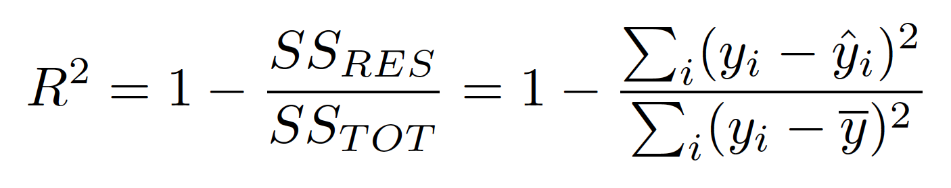
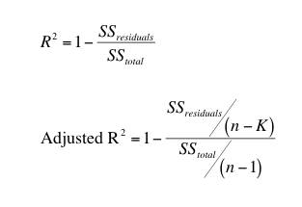
Formula for R squared & Adjusted R Squared
Where
n= Sample Size
K= No. of features

Slide 38
Conclusion
In This Project we started out with a problem statement given to us by the stakeholders of an FMCG company who entered into the instant noodles business two years back and the higher management wants to optimize the supply quantity in every warehouse in the entire country based upon the historical data to predict the optimum weight of the product to be shipped each time to the warehouse.
We started out with analyzing the data to get some important insights from the data for the stakeholders, we also performed demand pattern analysis for an effective marketing drive in the particular pockets of the country then we did some data preprocessing before creating a model and tried to get a model that gives the best predictions and in that pursuit we got a model that can predict the output with not 80, not 90 but with 99% accuracy, and that too without any overfitting, bias or variance.
So this concludes our project.

Slide 39
Bonus
After creation of the model instead of keeping that model in the jupyter notebook I thought why not make the job of the stakeholders even easier who gave us the project by deploying it to a web application where the stakeholder has to just enter few details about the warehouse and can predict the amount of product to be shipped to the warehouse with not 80, not 90 but with 99% accuracy.

Slide 40

Thank You

